Slide 1

Hello, &
WELLCOME
To ALL.

Slide 2

HOSPITAL MANAGEMENT SYSTEM
MySQL BASE
Presenting By Amit Shinde

Slide 3
AIM OF PROJECT
Data Management Efficiency:
Appointment Scheduling and Tracking:
Patient Treatment and Medication Management:
Doctor-Patient Interaction and Care Coordination:
Hospital Department and Resource Allocation:

Slide 4
Introduction
The Hospital Management System (HMS) is a comprehensive database solution designed to streamline hospital operations and improve patient care. It efficiently manages critical data such as patient records, doctor profiles, appointment scheduling, treatment history, and billing information. The system integrates key components like Patients, Doctors, Departments, Appointments, and Medications to ensure seamless data flow and accessibility. By automating administrative tasks and improving coordination between healthcare professionals, the HMS enhances operational efficiency, reduces errors, and ensures timely medical services. This project aims to provide a user-friendly interface to manage and retrieve hospital data efficiently.

Slide 5
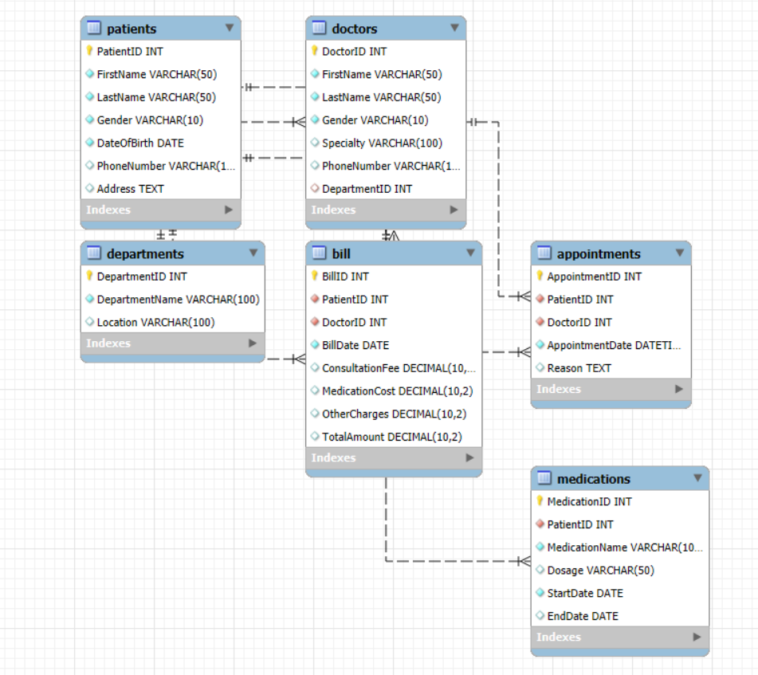
ENTITY RELATIONSHIP DIAGRAM

Slide 6
Tables In Project
Patients
Doctors
Departments
Appointments
Medications
Bill

Slide 7
Description Of Tables

Slide 8
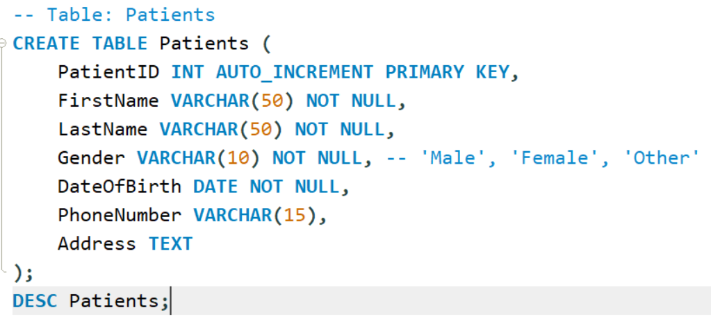
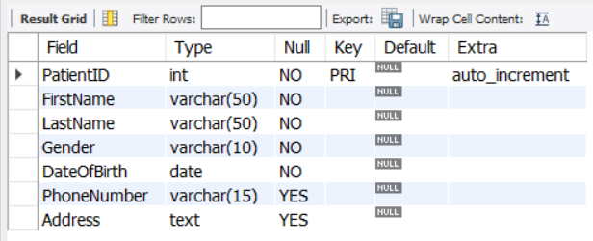
Table Patients

Slide 9
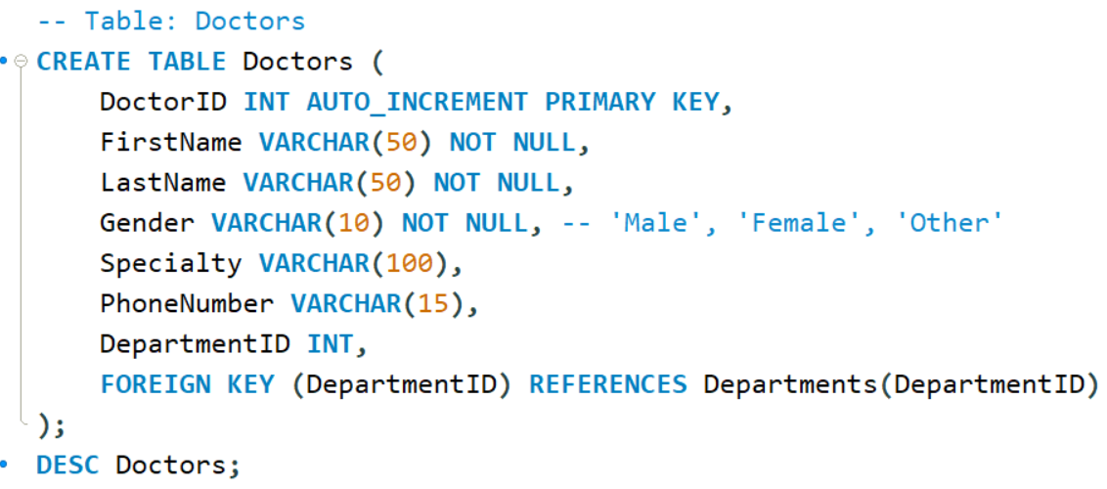
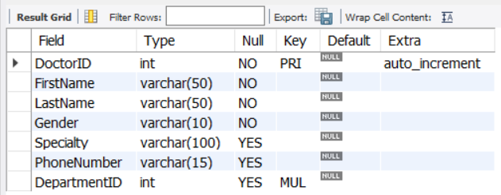
Table Doctors

Slide 10
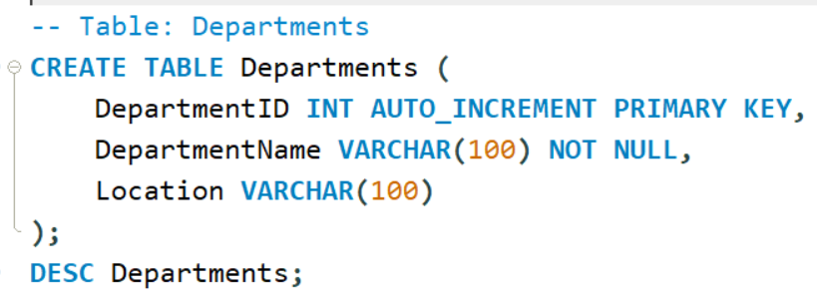
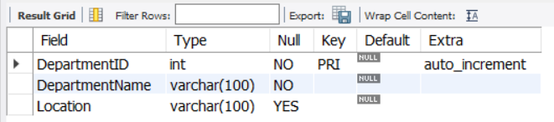
Table Departments

Slide 11
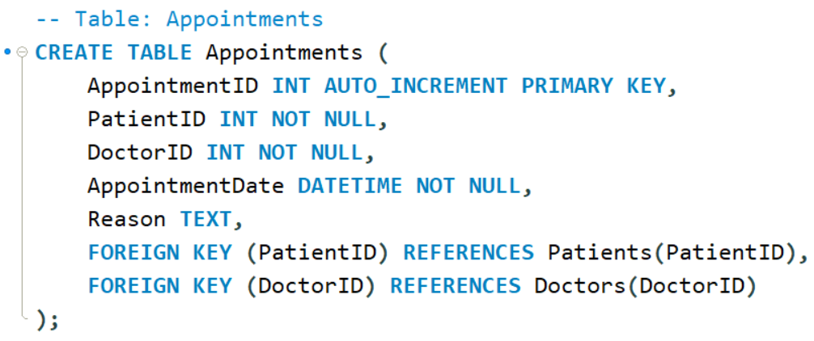
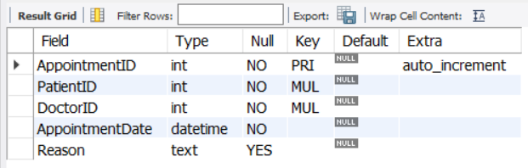
Table Appointments

Slide 12
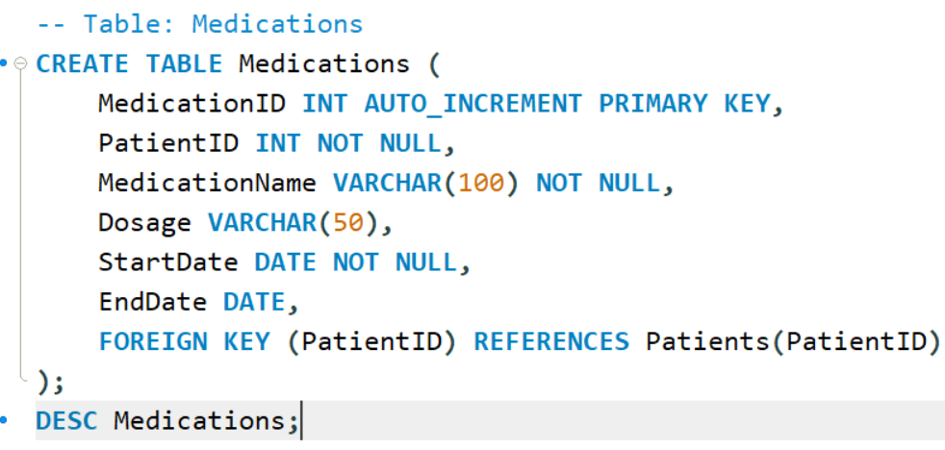
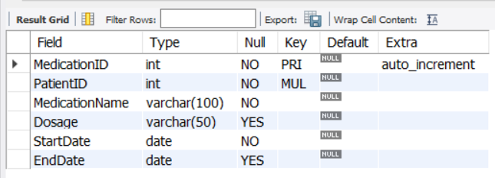
Table Medications

Slide 13
INSERTING

Slide 14
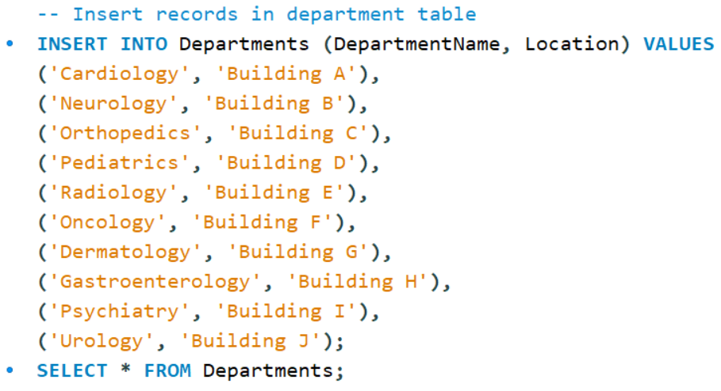

In Departments Table

Slide 15
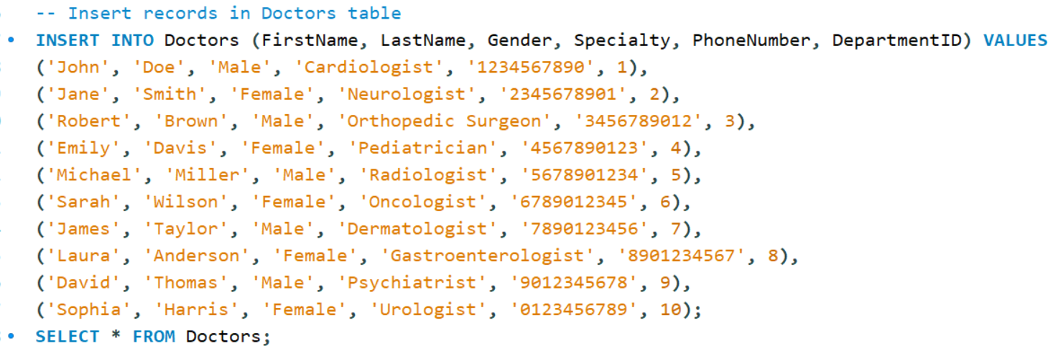
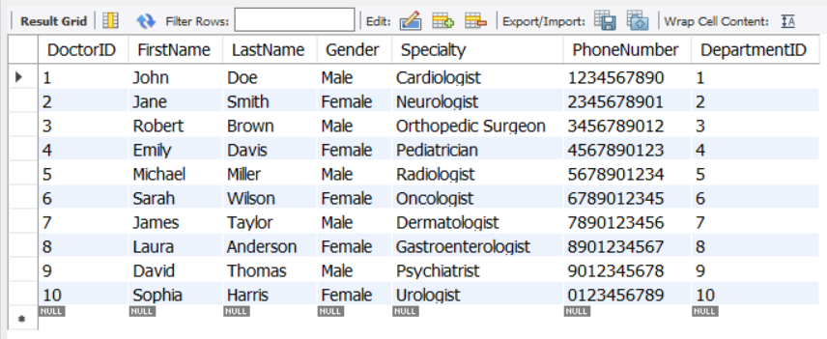
In Doctors Table

Slide 16
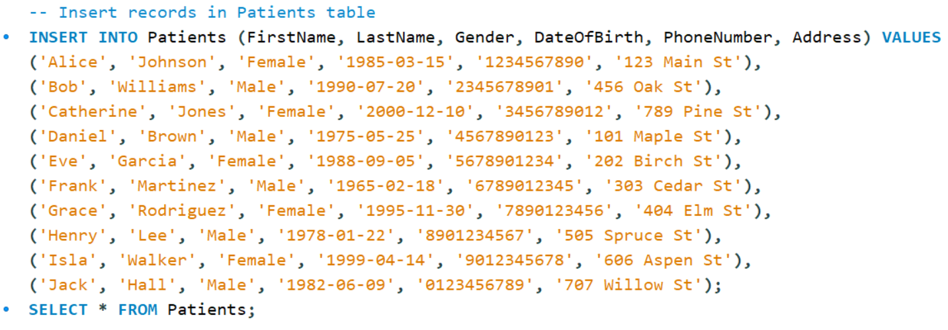
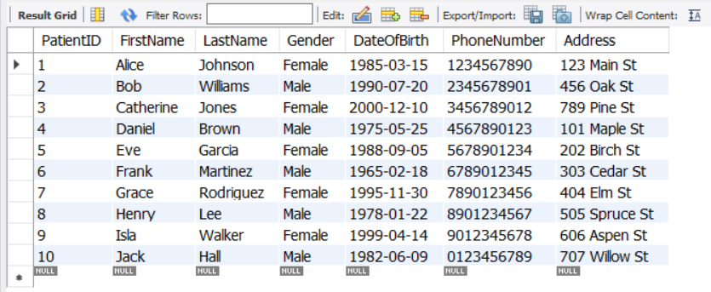
In Patients Table

Slide 17
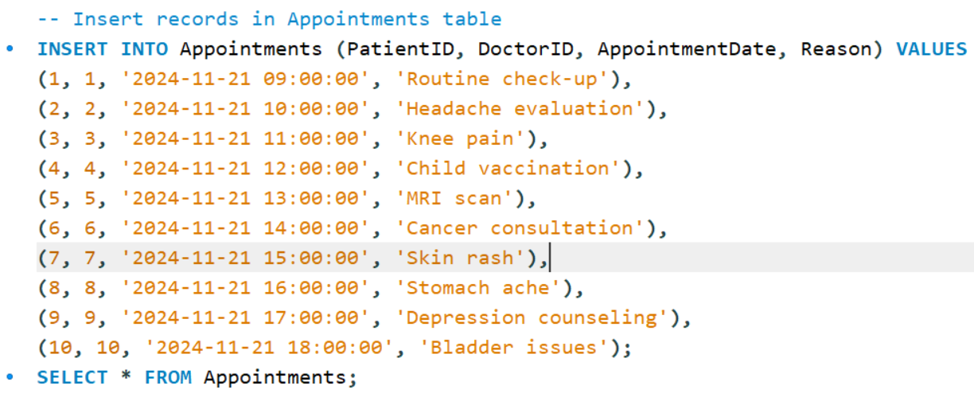
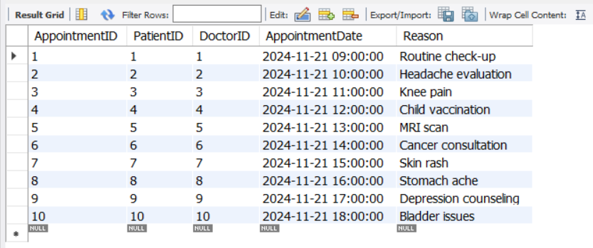
In Appointment Table

Slide 18
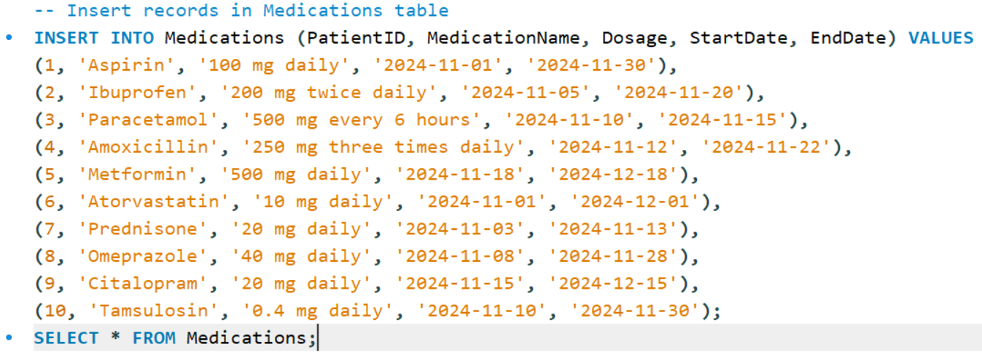
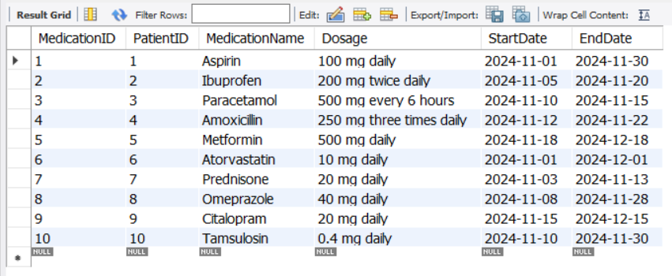
In Medications Table

Slide 19
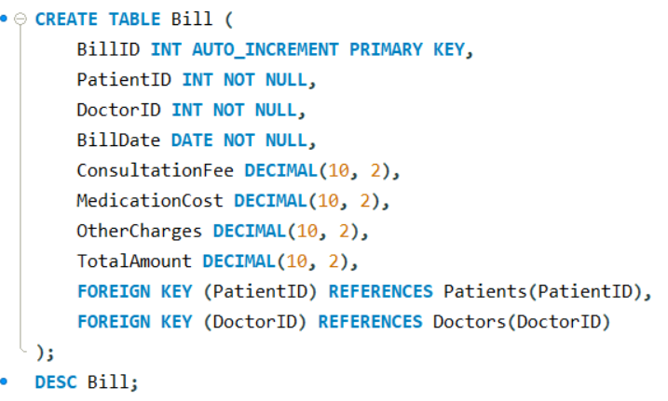
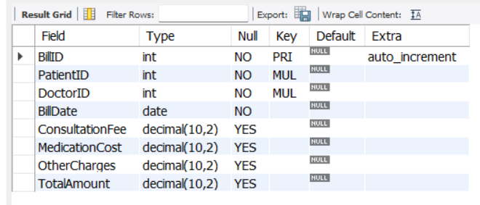
In Bill Table

Slide 20
Performing DML Operations

Slide 21
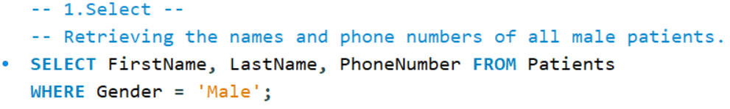
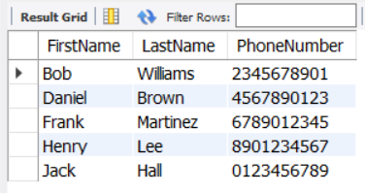
Using Select, Retrieving the names and phone numbers of all male patients.
SELECT
The SELECT statement in MySQL is used to query and retrieve data from one or more tables in a database.

Slide 22
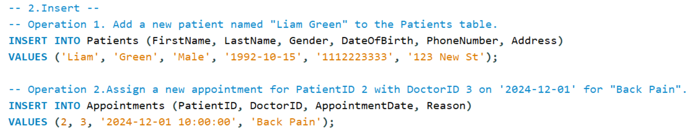
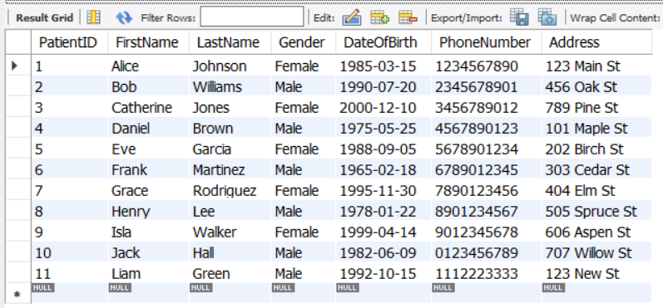
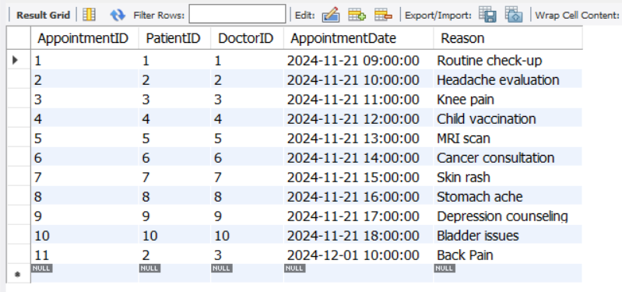
Using Insert, 1. Add a new patient name "Liam Green" to the Patients table. 2. Assign a new appointment for Patient ID 2 with Doctor ID 3 on '2024-12-01' for "Back Pain".
INSERT
In MySQL, the INSERT statement is used to add new rows of data to a table.

Slide 23
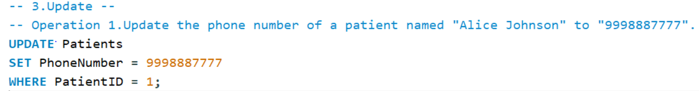
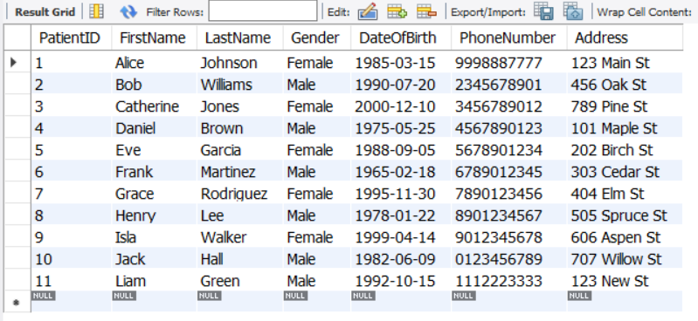
Using Update, Update the phone number of a patient named "Alice Johnson" to "9998887777".
UPDATE
The UPDATE statement in MySQL is used to modify existing records in a table.

Slide 24
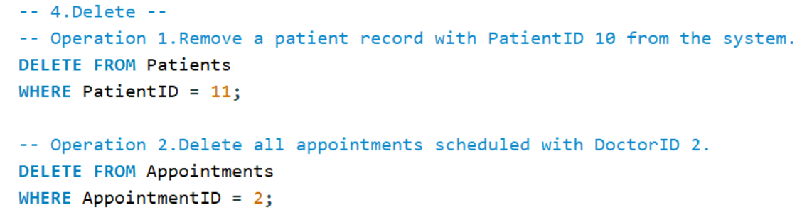
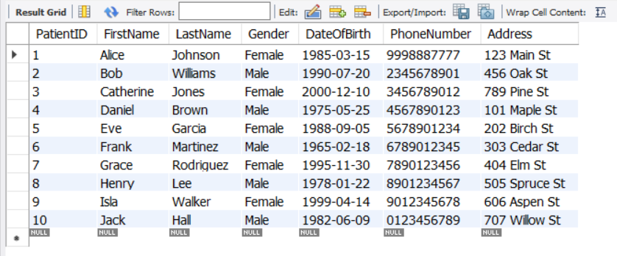
Using Delete, 1. Update the phone number of a patient named "Alice Johnson" to "9998887777". 2. Delete all appointments scheduled with Doctor ID 2.
DELETE
In MySQL, DELETE is a statement used to remove rows from a table based on a specified condition.

Slide 25
Performing DDL Operations

Slide 26
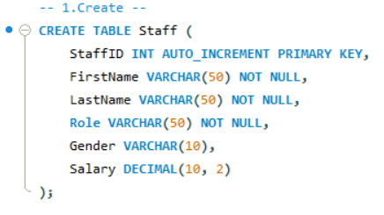
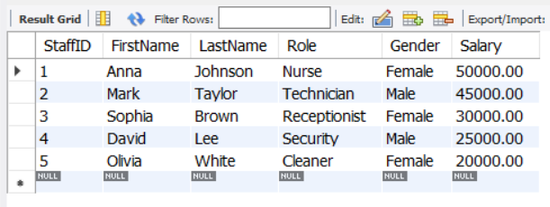
Using Create, 1. Create a table Staff to store staff details, and add 5 records to it.
CREATE
In MySQL, the CREATE statement is used to create a new database, table, index, or other objects.

Slide 27
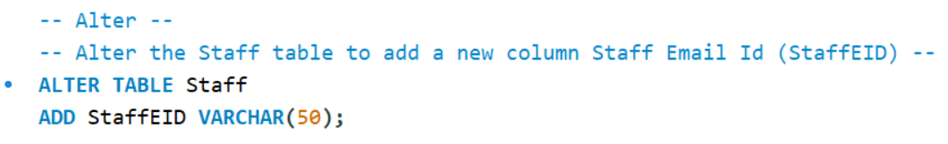
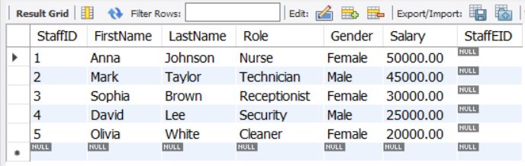
Using Alter, 1. ADD Coleman Staff Education(StaffEID)
ALTER
In MySQL, the ALTER statement is used to modify an existing database table.

Slide 28
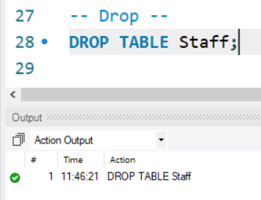
Using Drop, 1. Drop the Staff table from the database.
DORP
In MySQL, DROP is a SQL command used to delete a database, table, index, or other objects permanently.

Slide 29
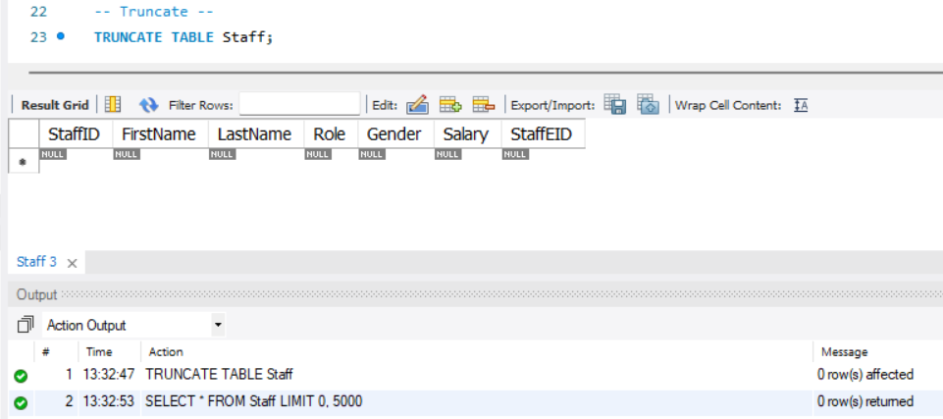
Using Truncate, 1. Truncate the Staff table from the database.
TRUNCATE
In MySQL, TRUNCATE is a Data Definition Language (DDL) command used to quickly delete all rows from a table, resetting the auto-increment counter, if any.

Slide 30
Performing DQL Operations

Slide 31

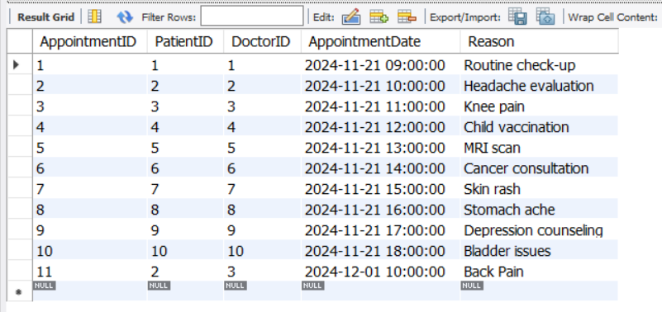
Using Select, 1. Select the Appointment.
SELECT
In MySQL, the SELECT statement is used to retrieve data from one or more tables.

Slide 32
Operator

Slide 33
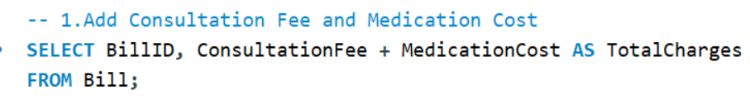
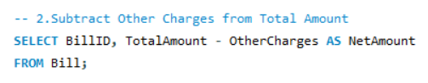
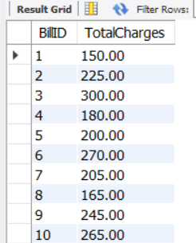
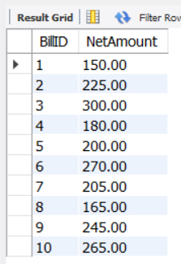
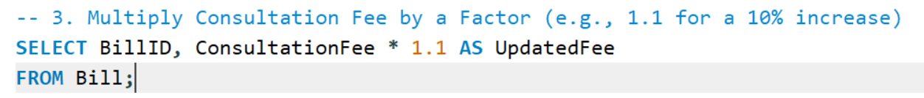
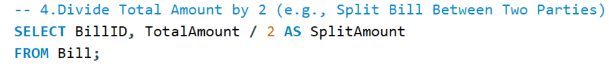
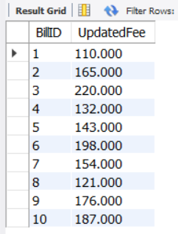
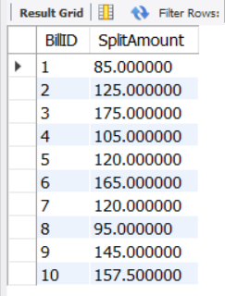
Arithmetic Operators
1. Addition (+): Adds two values together.
2. Subtraction (-): Subtracts the second value from the first.
3. Multiplication (*): Multiplies two values.
4. Division (/): Divides the first value by the second.

Slide 34
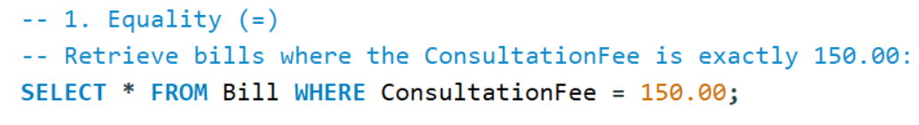
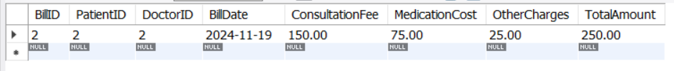
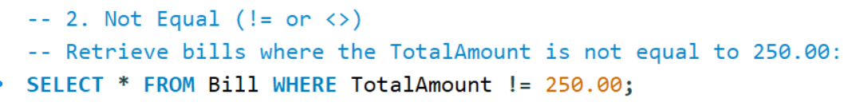
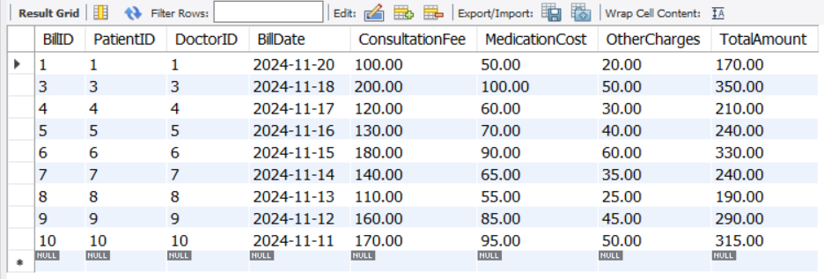
Comparison Operators
1. = : Checks if two values are equal.
2. != or <>: Checks if two values are not equal.

Slide 35




3. <: Checks if the left value is less than the right value.
4. >: Checks if the left value is greater than the right value.

Slide 36



5. <=: Checks if the left value is less than or equal to the right value.
6. >=: Checks if the left value is greater than or equal to the right value.

Slide 37




Logical Operators
1. AND: Returns TRUE if all conditions are true.
2. OR: Returns TRUE if any condition is true.
3. NOT: Reverses the result of a condition (TRUE becomes FALSE and vice versa).

Slide 38




Range operator
1. BETWEEN: Retrieves values within a given range (inclusive of the boundary values).
2. NOT BETWEEN: Retrieves values outside the specified range.

Slide 39




List operator
1. IN: Checks if a value exists in a given list of values.
2. NOT IN: Checks if a value does not exist in a given list of values.

Slide 40
SQL Keywords And Clause

Slide 41




ORDER BY
The ORDER BY clause in SQL is used to sort the result set of a query in either ascending (ASC) or descending (DESC) order based on one or more columns. By default, the sorting order is ascending if not explicitly mentioned.

Slide 42

DISTINCT Keyword
The DISTINCT keyword in SQL is used to remove duplicate rows from the result set and return only unique values in the specified column(s). It is particularly useful when you want to retrieve a list of unique entries from a column that may contain duplicates.

Slide 43




LIKE operator
The LIKE operator in SQL is used to search for a specified pattern in a column.
1. % Wildcard: Match Zero or More Characters.
2. _ Wildcard: Match Exactly One Character

Slide 44
SQL Functions

Slide 45




String Function
In MySQL, string functions are used to perform operations on string data, such as manipulating or retrieving specific information
1. CONCAT(): Concatenate two or more strings.
2. LOWER(): Convert a string to lowercase.
3. LENGTH(): Get the length of a string.
4. SUBSTRING(): Extract a part of a string.

Slide 46
3. LENGTH(): Get the length of a string.
4. SUBSTRING(): Extract a part of a string.

Slide 47




Math Function
In MySQL, math functions are used to perform mathematical calculations.
1. ROUND(): Round to a Specified Number of Decimal Places
2. CEIL(): Round Up to the Nearest Integer
3. FLOOR(): Round Down to the Nearest Integer
4. POWER(): Raise a Number to a Power

Slide 48


Aggregate Function
An aggregate function in MySQL performs a calculation on a set of values and returns a single value, commonly used with the GROUP BY clause. Examples include SUM(), AVG(), MAX(), MIN(), and COUNT().
1. Count the Number of Records
2. Calculate the Total

Slide 49



3.Calculate the Average
4.Find the Maximum Value
5.Find the Minimum Value

Slide 50

GROUP BY with HAVING
1. Find the total amount spent by each patient and list only those who have spent more than 300.

Slide 51

Subquer

Slide 52

A subquery is a nested query within another SQL query. Subqueries can be used in various clauses like SELECT, FROM, WHERE, etc., to perform advanced data retrieval and filtering.
Get each patient's total expenses using a subquery.

Slide 53

JOINS

Slide 54

SQL joins are used to combine rows from two or more tables based on a related column.
1. INNER JOIN : Returns rows where there is a match in both tables.
Retrieve a list of appointments, including the patient's full name, doctor's full name, and the reason for the appointment.

Slide 55

2. LEFT JOIN :
A LEFT JOIN retrieves all rows from the left table and the matching rows from the right table. If there is no match, the result will contain NULL for columns from the right table.
List all doctors along with their patient's details (first name, last name) and the appointment reason. If a doctor has not been assigned to any appointments, still show the doctor’s information but with NULL values for the patient’s details.

Slide 56

3. RIGTH JOIN :
Returns all rows from the right table and matching rows from the left table. Non-matching rows from the left table will have NULL.
We want to list all medications prescribed to patients and the patient details associated with each medication. If a medication is not linked to a patient (for some reason), we still want to include the medication details, but with NULL values for patient details.

Slide 57

4.FULL JOIN:
Combines results of both LEFT JOIN and RIGHT JOIN. Returns all rows when there is a match in one of the tables.
We want to create a list of all patients and doctors. We'll use a UNION to combine their names (from both tables) into a single result. We'll select the first name and last name from both the Patients table and the Doctors table, and merge the two results into a single list.

Slide 58

VIWE

Slide 59

VIEW
A view in SQL is a virtual table that provides a way to store a query for future use. It is not a physical table but rather a stored SQL query that can be treated like a table in SELECT statements.
Scenario : Let's create a view that combines information from the Patients and Doctors tables to show a list of appointments, including the patient's name, doctor's name, and the appointment date.

Slide 60

Stored Procedure & Stored Function

Slide 61


Stored Procedure
A Stored Procedure is a precompiled collection of SQL statements and optional control-flow logic stored in a relational database.
Insert a new patient and return the PatientID

Slide 62

Stored Function
A Stored Function in MySQL is a reusable SQL code block that performs a specific task and returns a single value.
Calculate a patient's age

Slide 63

SQL Cursor

Slide 64


In MySQL, a cursor is a database object that allows row-by-row processing of a result set.
The scenario will involve retrieving total consultation fees for a specific doctor over a date range.

Slide 65

SQL Trigger

Slide 66




A trigger in MySQL is a database object that is automatically executed or fired when a specified event occurs on a table.
AFTER :An AFTER trigger executes after the specified event has occurred.
BEFORE: A BEFORE trigger executes before the specified event occurs.

Slide 67
Thank You…..

